Slide 1
A Civic Learning Week Event
The State of Social Studies Education: Collaboratively Moving Forward
Lawrence M. Paska, Ph.D., CAE, NCSS Executive Director
Zachary Cote, Thinking Nation Executive Director
Monday, March 11, 2024
9:00 AM PT / 12:00 PM ET

Slide 2
What Exactly is “Social Studies”?
NCSS defines social studies as the study of individuals, communities, systems, and their interactions across time and place that prepares students for local, national, and global civic life.
NCSS’ vision:
A world in which all students are educated and inspired for lifelong inquiry and informed civic action.

Slide 3
Our Goals for Today
Map out the state of social studies education through the perspectives of the broader educator, the social studies teacher, and the social studies student.
Discuss both the frustrating and hopeful components of the state of social studies education.
Brainstorm a path forward to sustain, strengthen, and legitimize the field in ways that demonstrate the civic imperative of a healthy social studies education.

Slide 4
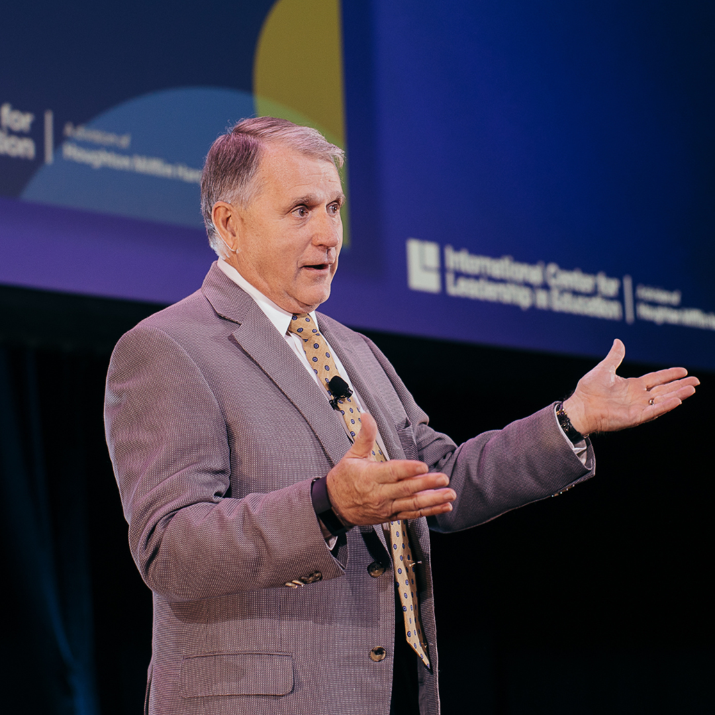
The Broader Education Perspective
Let’s begin by asking ourselves what the outside sees when looking in.
Dr. Bill Daggett is recognized worldwide for his proven ability to move PreK-12 education systems towards more rigorous and relevant skills and knowledge for all students.
For 30 years, he has led school reform efforts to effectively prepare students for their future.

Slide 5
The Broader Education Perspective
Conversation Questions
How does the broader education field see social studies education? Why?
What shifts do you think need to happen to sustain and grow social studies in a fast-changing landscape?
What can teachers and administrators do to demonstrate the civic imperative of social studies education to those outside education circles?
What can other education stakeholders (e.g., community leaders, business leaders, parents) do to support social studies education in schools?

Slide 6
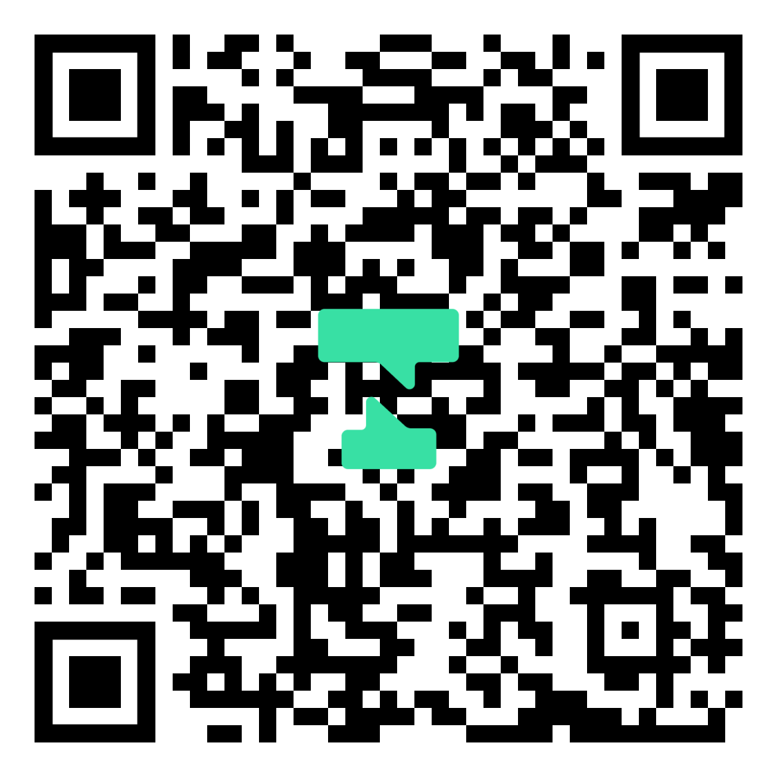
Do education stakeholders take us seriously?

Slide 7
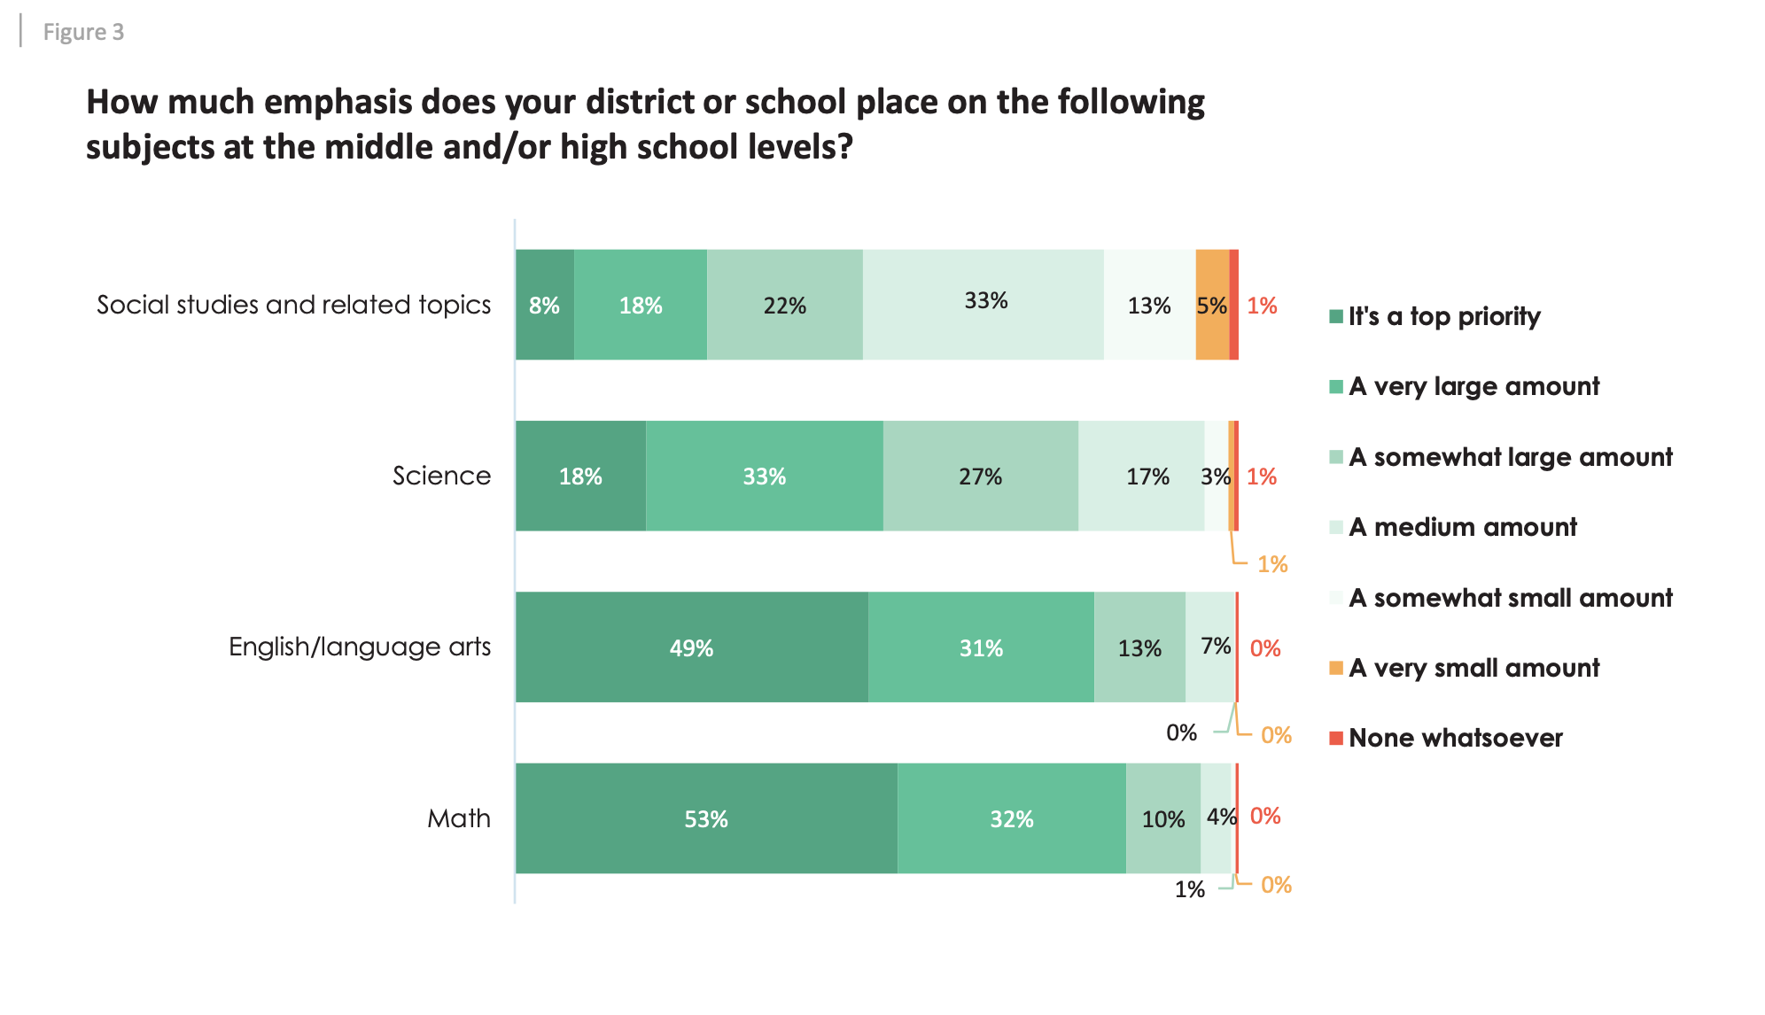
98% of educators say that education must prepare students for civic society.
8% say that social studies is a top priority at their school.

Slide 8
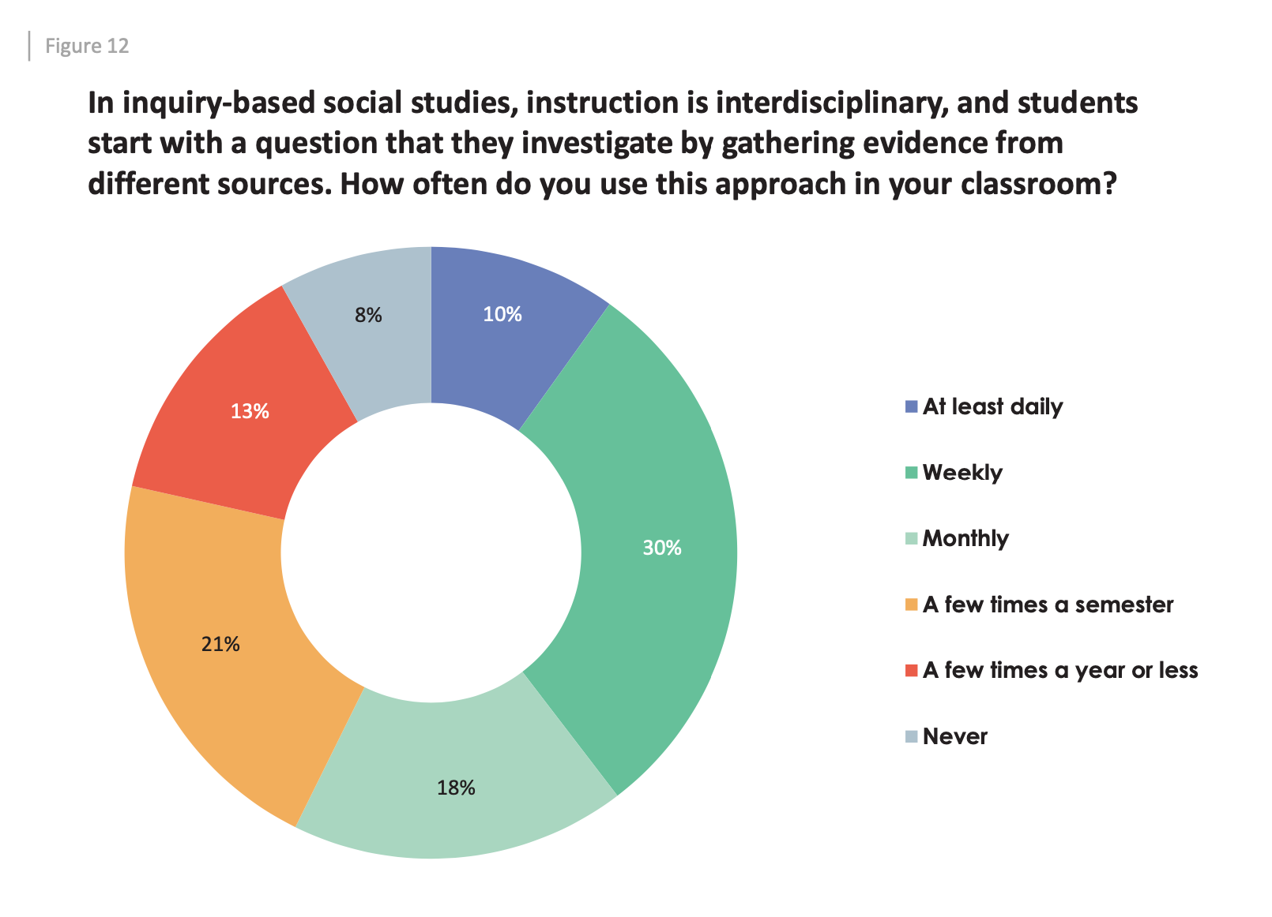
Less than half of secondary social studies teachers (40 percent) use the best practice of inquiry-based instruction at least once a week.

Slide 9
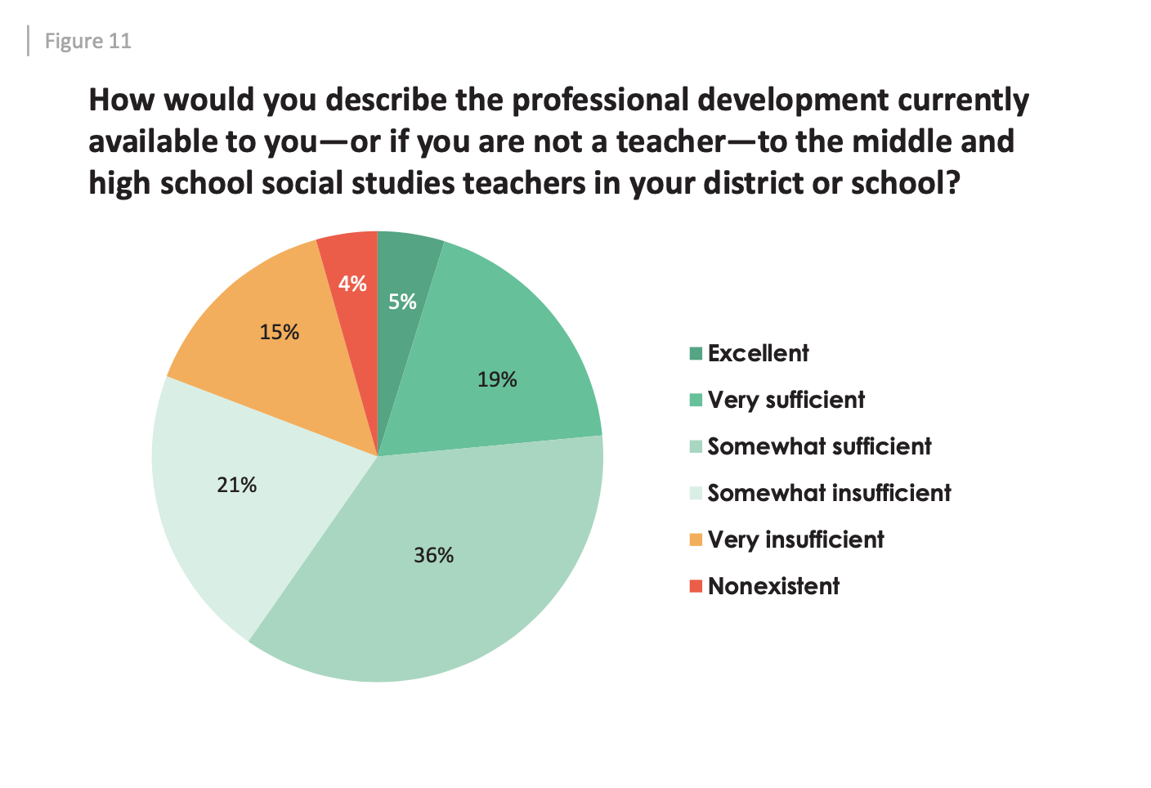
Less than 1 in 4 say that social studies professional development in their districts or schools is very sufficient or excellent.

Slide 10
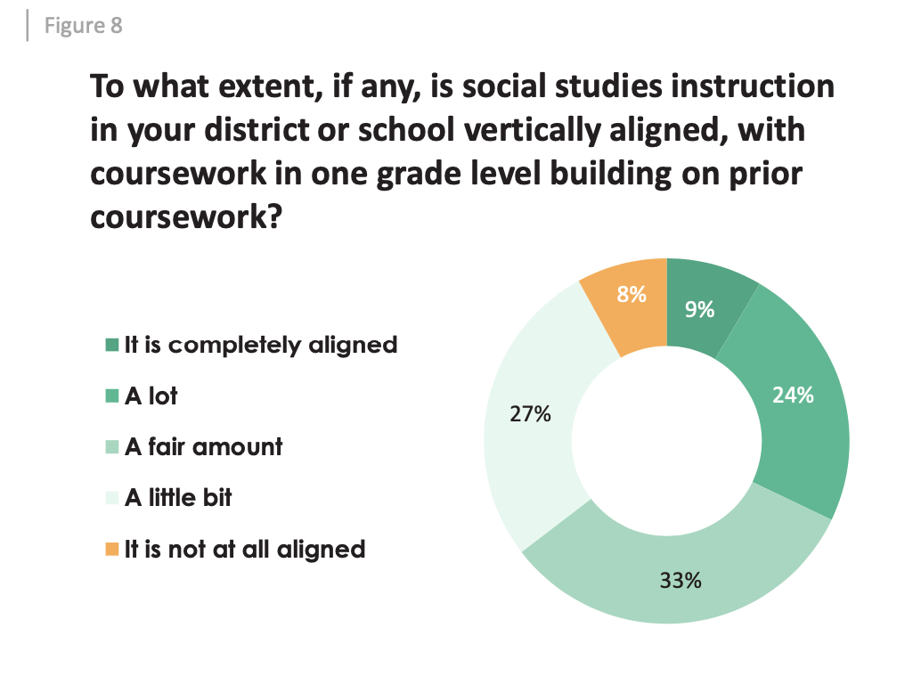
While most respondents (61%) say it is very important or a top priority for social studies instruction to be vertically aligned… less than 1 in 3 report that there is a lot of alignment or complete alignment.

Slide 11
Academic Skills Development in
Social Studies Classes
Over 90% of students in social studies classes report gaining academic skills as a result of their social studies coursework.
58%
Ability to form and support an opinion
56%
Critical thinking
49%
Ability to evaluate concepts/ideas
47%
Reading comprehension
44%
Writing skills
35%
Ability to present information in a clear/concise manner
35%
Ability to navigate digital and print sources to find information
Findings from myOptions® EncourageTM/NCSS research study (2022): National sample includes 32,745 high school students in social studies classrooms and 677 social studies educators.

Slide 12
Civic Benefits Gained in
Social Studies Classes
Nearly 93% of all students report gaining civic benefits in social studies classes.
Knowledge of world events
76%
Understanding my role as a citizen
49%
32%
Ability to understand politics
43%
Understanding career options and the economy
23%
Interest in becoming involved in the community
Findings from myOptions® EncourageTM/NCSS research study (2022): National sample includes 32,745 high school students in social studies classrooms and 677 social studies educators.

Slide 13
Top Four Social Studies Program Additions Desired by Students
Additional interaction with politicians/community speakers
More service learning/community service opportunities
25%
29%
76%
23%
Larger variety of social studies course offerings in my school
More field trips to museums/ historical sites
Findings from myOptions® EncourageTM/NCSS research study (2022): National sample includes 32,745 high school students in social studies classrooms and 677 social studies educators.

Slide 14
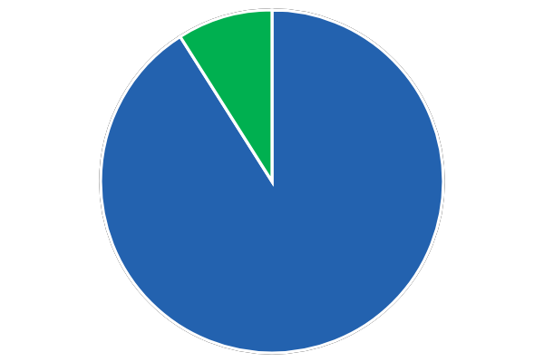
Perceived Importance of
Social Studies Courses
Students said that social studies courses were important based on current political and social issues.
91%
Findings from myOptions® EncourageTM/NCSS research study (2022): National sample includes 32,745 high school students in social studies classrooms and 677 social studies educators.

Slide 15
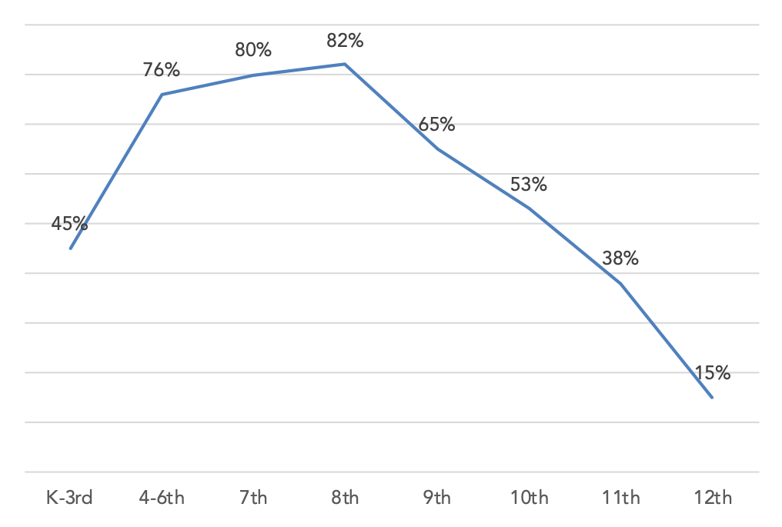
Social Studies Coursework
by Grade Level
Findings from myOptions® EncourageTM/NCSS research study (2022): National sample includes 32,745 high school students in social studies classrooms and 677 social studies educators.

Slide 16
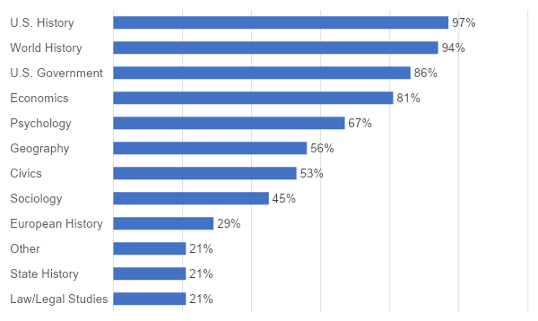
Social Studies Courses Available
Findings from myOptions® EncourageTM/NCSS research study (2022): National sample includes 32,745 high school students in social studies classrooms and 677 social studies educators.

Slide 17
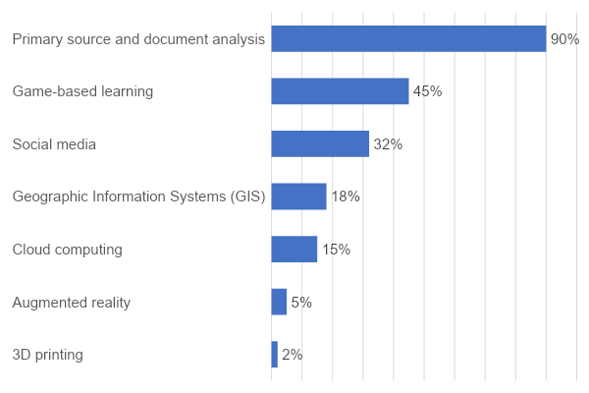
Use of Technology in the Classroom
Findings from myOptions® EncourageTM/NCSS research study (2022): National sample includes 32,745 high school students in social studies classrooms and 677 social studies educators.

Slide 18
Greatest Challenges Facing Social Studies Educators
Educators were asked to report the greatest challenges facing their programs.
49%
Larger class sizes
42%
Shift in focus to standardized testing/high stakes testing
43%
Marginalization of social studies
32%
Lack of scheduled time for collaboration with colleagues
37%
Limited funding/decreasing budgets
Findings from myOptions® EncourageTM/NCSS research study (2022): National sample includes 32,745 high school students in social studies classrooms and 677 social studies educators.

Slide 19
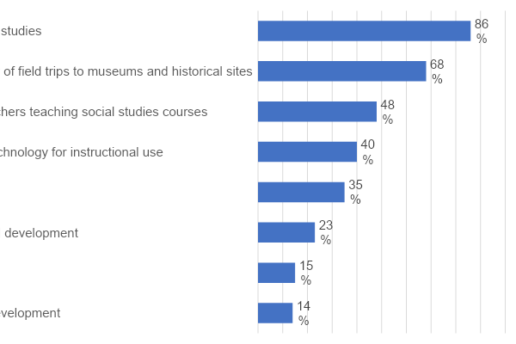
Top Uses for Additional Federal Funding
Findings from myOptions® EncourageTM/NCSS research study (2022): National sample includes 32,745 high school students in social studies classrooms and 677 social studies educators.

Slide 20
Elementary Social Studies
Rightfully so, more research and recommendations have come out in the last few years that highlight how essential social studies is for a quality elementary experience. Three such examples are:
2020 Fordham Institute Study: “Social Studies Instruction and Reading Comprehension: Evidence from the Early Childhood Longitudinal Study”
2023 Rand Corporation Study: “The Missing Infrastructure for Elementary (K–5) Social Studies Instruction”
2023 CCSSO Guidelines: “Effective Social Studies Integration in Elementary Classrooms”

Slide 21
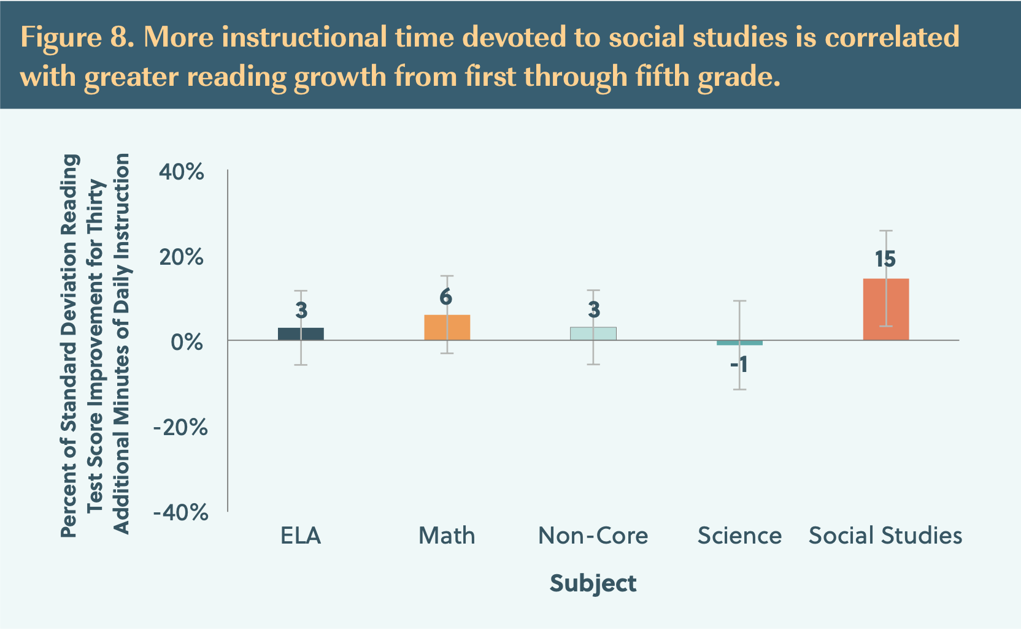
2020 Fordham Institute Study

Slide 22
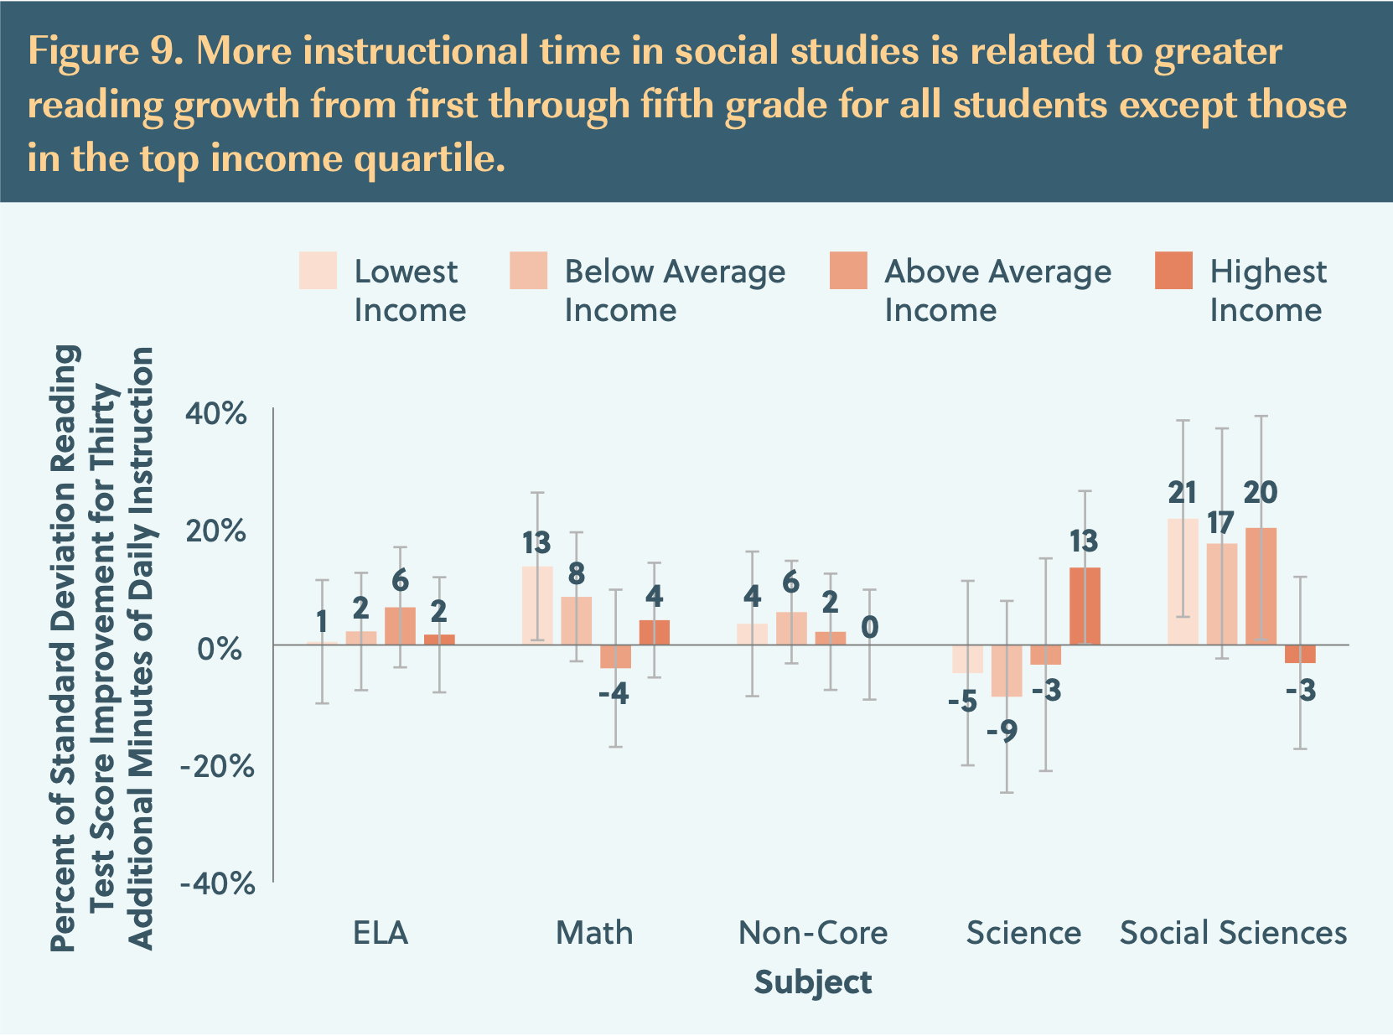
2020 Fordham Institute Study

Slide 23
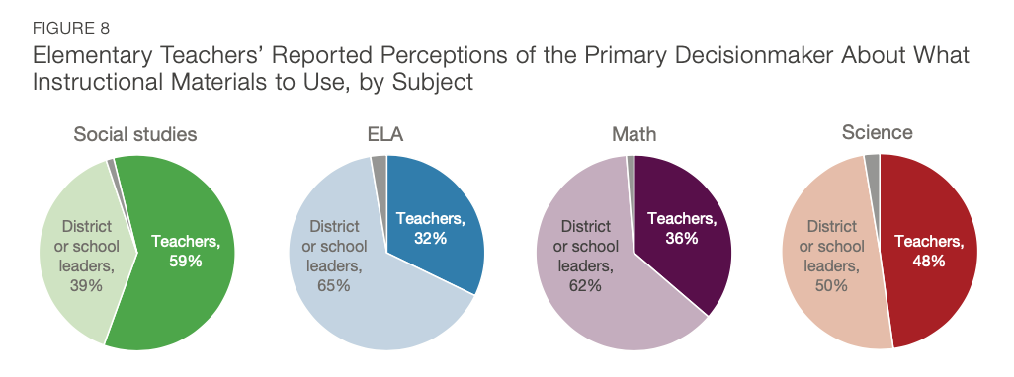
2023 Rand Corporation Study

Slide 24
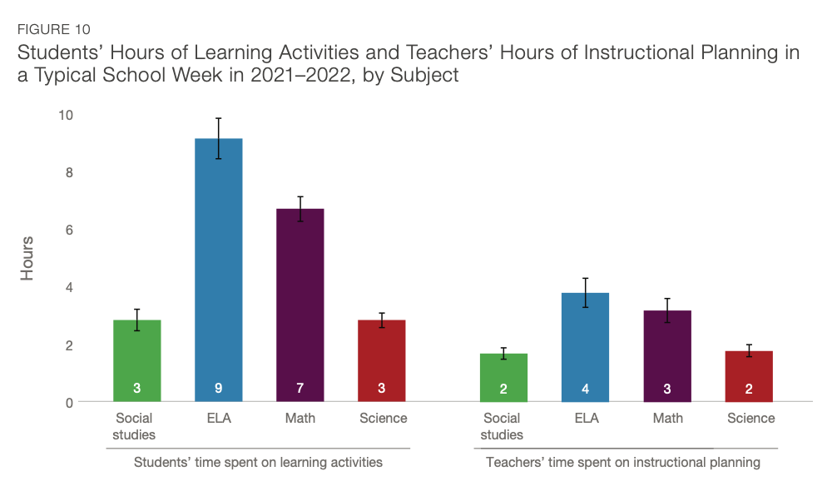
2023 Rand Corporation Study

Slide 25
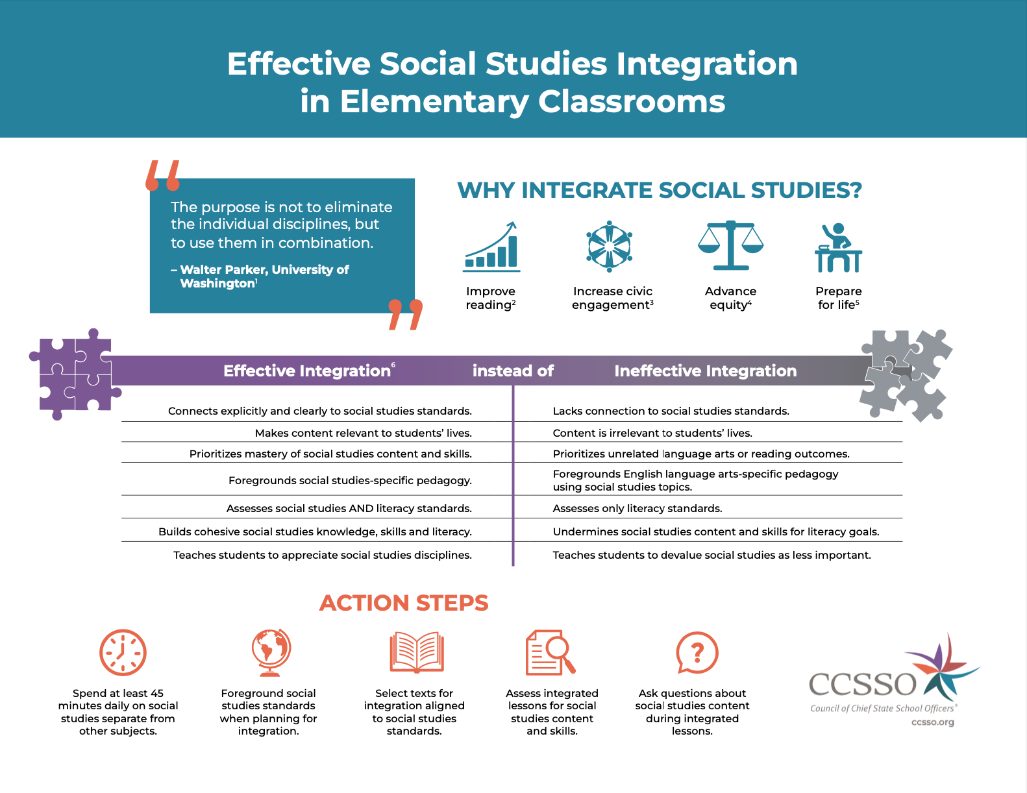
2023 CCSSO Guidelines
CCSSO Social Studies Collaborative, Fran O’Malley (advisor), Mike Feldman (DE), Scott Abbott (DE) Nate McAlister (KS), and Heather Ransom (KY)

Slide 26
THANK YOU!
www.socialstudies.org
X: @NCSSNetwork
www.thinkingnation.org
X: @Thinking_Nation
#NCSS2024
#socialstudies

