Slide 1
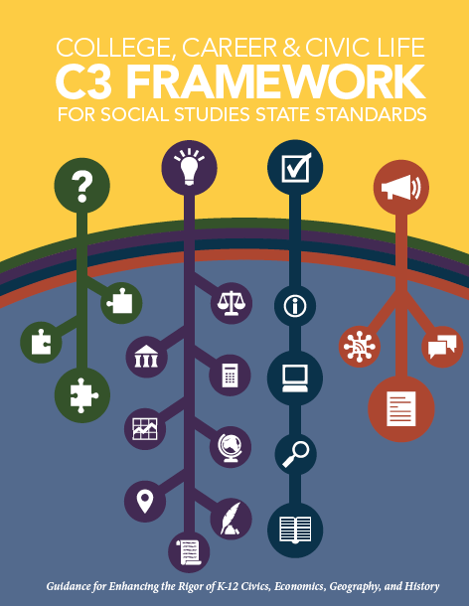
Developing Questions And planning Inquiries
C3 Literacy Collaborative
National Council for the Social Studies in collaboration with the National Center for Literacy Education
Developed by
S. G. Grant
Professor of Social Studies Education
Binghamton University
Funded by the Bill and Melinda Gates Foundation
Notes:
Script:

Slide 2
Welcome!
[Presenter photo]
S. G. Grant
Professor of Social Studies Education
Binghamton University
sggrant@binghamton.edu
Notes:
Script:

Slide 3
Purpose:
As a result of participating in this Investigation, you will become familiar with:
The importance of questions in framing a unit of study
The relationship between compelling and supporting questions
The distinctive features of compelling and supporting questions
Notes:
Good afternoon. I’m S. G. Grant, Professor of Social Studies Education and a Senior Advisor and Contributing Writer on the C3 Framework. I’m pleased to be part of this program of webinars aimed at supporting the implementation of the Framework
Explain: In this session, we focus on Dimension 1 of the C3 Framework—Developing Questions and Planning Inquiries. Ensuing investigations will look at the other dimensions of the Inquiry Arc and topics such as using the C3 in teacher education.

Slide 4
Why Questions?
“By doubting we are led a question, by questioning we arrive at the truth.” —Peter Abelard
“It is better to debate a question without settling it than to settle a question without debating it.” —Joseph Joubert
“We get wise by asking questions, and even it there are not answered, we get wise, for a well-packed question carries its answer on its back as a snail carries its shell.” —James Stephens
“It is not the answer that enlightens but the question.” —Eugene Ionesco
“If you do not know how to ask the right question, you discover nothing.” —W. Edwards Deming
“One of the very important characteristics of a student is to question. Let the students ask questions.” —A. P. J. Abdul Kalam
“The art and science of asking questions is the source of all knowledge.” —Thomas Berger
Notes:
From Socrates on, the value of questions in general and for teaching and learning in particular has been well established. In Plato’s Protagoras, Socrates claims, “my way toward truth is to ask the right questions.” Answers are important, but a well-framed question can excite the mind and give real and genuine meaning to the study of any social issue.
As you can see from these quotes, questions have gotten a lot of attention….And by a wide range of thinkers—from philosophers to dramatists to poets and scientists….My favorite it is the last: “The art and science of asking questions is the source of all knowledge.”
So if we are going to talk about inquiry-based teaching, a good place to start is with questions….

Slide 5
IDM Follows C3 Inquiry Arc
If students are asked a COMPELLING QUESTION …
In the middle are the SUPPORTING QUESTIONS, FORMATIVE TASKS, and SOURCES
Students answer in the form of a SUMMATIVE
ARGUMENT
Notes:
And questions are where the C3 Framework starts…..
In content-rich subjects such as social studies, teaching and learning have traditionally focused on finding facts first and thinking later. That approach has not worked for all students. The C3 Inquiry Arc reframes that traditional approach by highlighting the use of questions as a way to drive a social studies inquiry.
So let’s now turn to compelling and supporting questions. We’ll begin with a short piece of video where I talk about the nature of questions and the Inquiry Arc. Then we’ll dig deeper into the distinctive features of compelling and supportive questions.
Play segment 20:45-25:05 from the Herzog video.
Following the video:
Reflect and discuss:
What does Bruner’s quotation mean to you?
How do you see the relationship between questions and ideas?
What potential do you see for creating multidisciplinary inquiries?

Slide 6
Compelling Questions
Characteristics of compelling questions:
Set the opening frame for an inquiry
Express the intellectual rigor and student relevance of an inquiry
Set up the summative performance task
Notes:
Of course, not all questions are alike or are equally useful for instruction. So let’s look more specifically at compelling questions—both what defines them and examples. Then I’d like you to try your hand at creating a couple.
One of the primary characteristics of a compelling question is that it helps frame the inquiry under study. To that end, a compelling question helps teachers and students collect, organize, and pursue their ideas through the task of answering the question.
Compelling questions are also intellectually rigorous and relevant to students. Compelling questions address key issues, topics, and problems found in and across the academic disciplines in general and the New York State K–12 Social Studies Framework in particular. But compelling questions also reflect the ideas and experiences that students bring to class.
Finally, compelling questions give direction to students in terms of their summative performance task.

Slide 7
Crafting Compelling Questions
Intellectually rigorous
Relevant to students
Notes:
The key to crafting compelling questions is hitting the sweet spot between the qualities of being intellectually rigorous and relevant to students.

Slide 8
Intellectually rigorous
A compelling question:
Reflects an enduring issue, concern, or debate in the field
Demands the use of multiple disciplinary lenses and perspectives
Notes:
An intellectually meaty question has two characteristics.
First, it reflects an enduring issue, concern, or debate in social studies. Compelling questions speak to the big ideas of history and the social sciences, both in concept and in particular. Revolution is an important and useful concept, but students need to understand that the American, French, and Russian revolutions, while sharing some traits, differed radically. Students understand some things by knowing the concept of revolution, but their understandings develop exponentially when they can see how the particulars of different kinds of revolutions have played out.
Second, compelling questions demand the use of multiple disciplinary lenses and perspectives. No social problem is economic, political, historical, or geographic alone. The challenges we face in society are multifaceted, so they demand that we use the power of history and the social science disciplines both individually and in combination to address them.
And if the study of social issues benefits from a multidisciplinary approach, so, too, does it benefit from examination from multiple perspectives. There is no social problem or issue on which there is universal agreement, so it only makes sense to examine those that teachers put in front of students from differing vantage points.

Slide 9
Relevant to students
A compelling question:
Reflects one or more qualities or conditions that we know children care about
Honors and respects children’s intellectual efforts
Notes:
Compelling questions need to be worth investigating from an academic angle, but they also need to be worth exploring from a student angle. Recall Jerome Bruner’s claim—”any subject can be taught effectively in some intellectually honest form to any child at any stage of development.”
To take this point seriously does not mean that we have to dumb down the curriculum. In fact, it means just the opposite: Teachers should teach intellectually ambitious material. The key is to see within the ideas to be taught those elements that teachers know their students care about. It is not the case that students are uninterested in natural resources or supply and demand or the New Deal, per se. It is the case that teachers need to pull from those ideas relevant connections to students’ lives.

Slide 10
What do kids care about?
Notes:
So what do students care about? Teachers tend to have less trouble identifying intellectually rigorous ideas than they do identifying the elements of those ideas that speak to students’ knowledge and experience. It is not that they can’t; it’s just that they already know the ideas are important and take for granted that students will too.
Lead short discussion of things kids care about.
Okay….now let’s try an assessment!

